Slide 1
Facilitating Success without Unicorns
A whole team approach to finding individual success

Slide 2
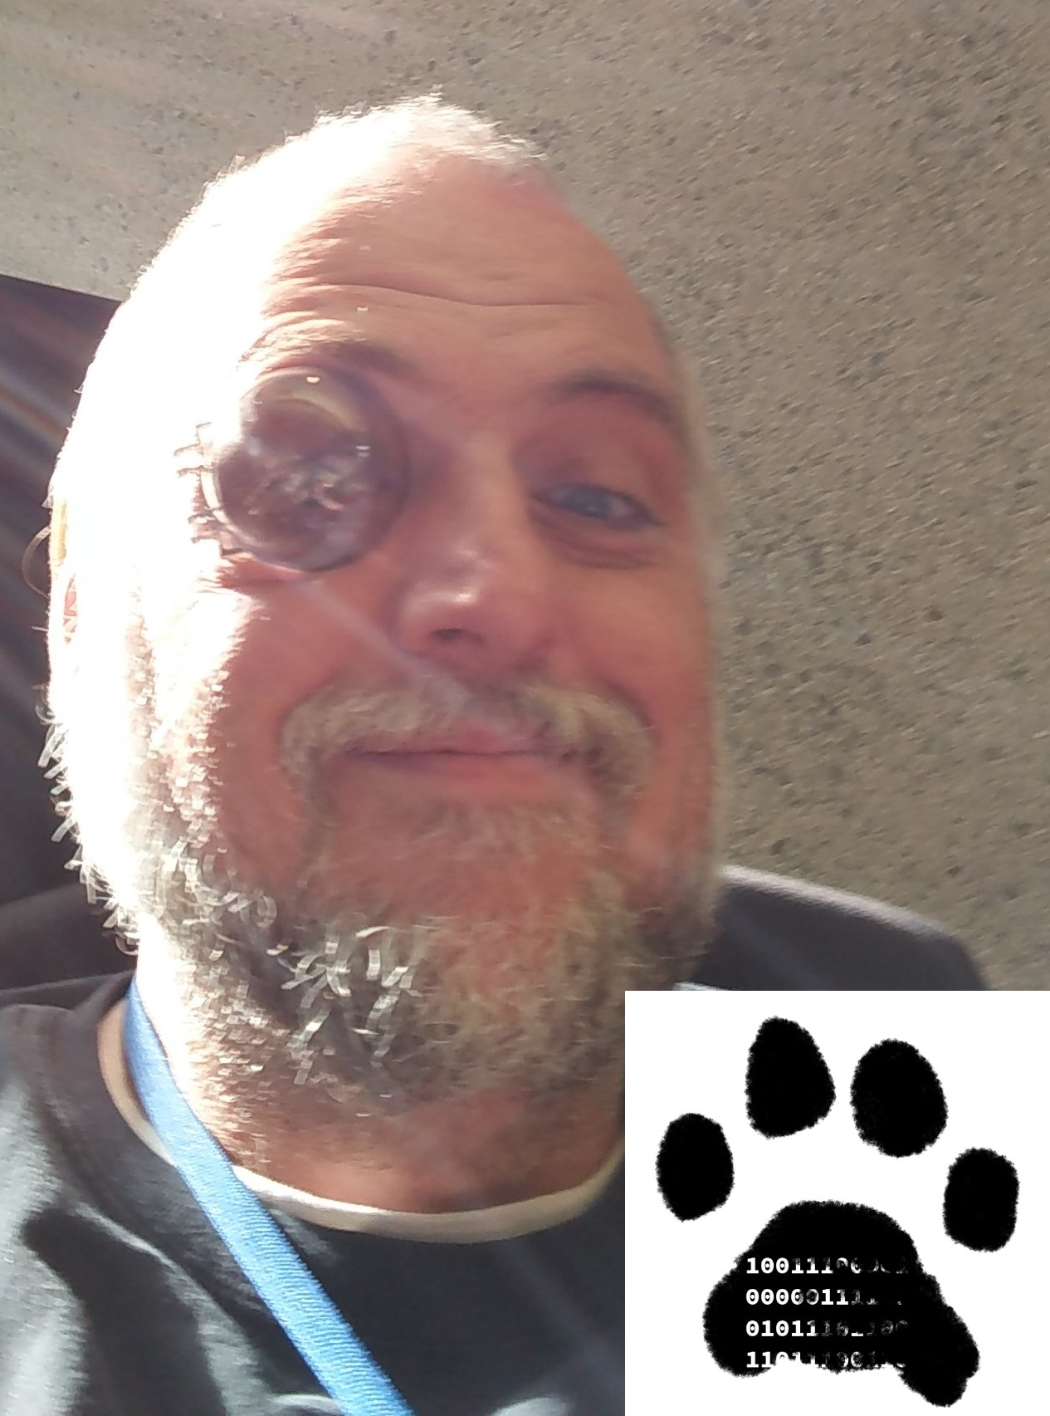
Who am I?
R. Jason Kerney
Mob Programmer
Lover of Community
Coach?
Father
Husband
19 Years in Industry
@JasonKerney

Slide 3

Introduction – Overview and plan
What is this talk about? Employee Feedback
What are my goals?
What am I going to cover?
"The value of another’s experience is to give us hope, not to tell us how or whether to proceed.“
Peter Block
@JasonKerney
Notes:
Employee Feedback.
Share Inspiration
Questions

Slide 4

Not an Employee Review Process
@JasonKerney
Notes:
Give good feedback
Employee satisfaction
training budget
Individual Achievements
insight into employee goals

Slide 5

Gamification
@JasonKerney

Slide 6

Context. Context. Context.
@JasonKerney
Notes:
Flat department
Safety is a prerequisite
Prioritize Learning

Slide 7

Picture this…
@JasonKerney

Slide 8

Format – The Personal Retrospective
@JasonKerney
Notes:
Needs to be:
Safe
Personal & Private
Facilitated
This leads to:
Honest
Useful feedback
Relevant Feedback

Slide 9

Adding To Parking Lot
@JasonKerney

Slide 10
Adding To Parking Lot
@JasonKerney

Slide 11
Moving On
@JasonKerney

Slide 12

Facilitation by Peers
@JasonKerney
Notes:
By invite only, okay to refuse
Training includes:
Comprehensive Listening
Awkward Silence
Its okay to make mistakes

Slide 13

Opening The Retro
@JasonKerney
Notes:
Thank the person
Shake hands
Explain that retro is private

Slide 14
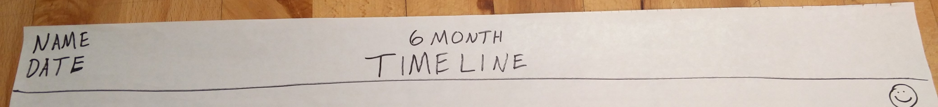
Opening The Retro
@JasonKerney
Notes:
Thank the person
Shake hands
Explain that retro is private

Slide 15

Time Line & Force Field
@JasonKerney
Notes:
Comprehension listening

Slide 16
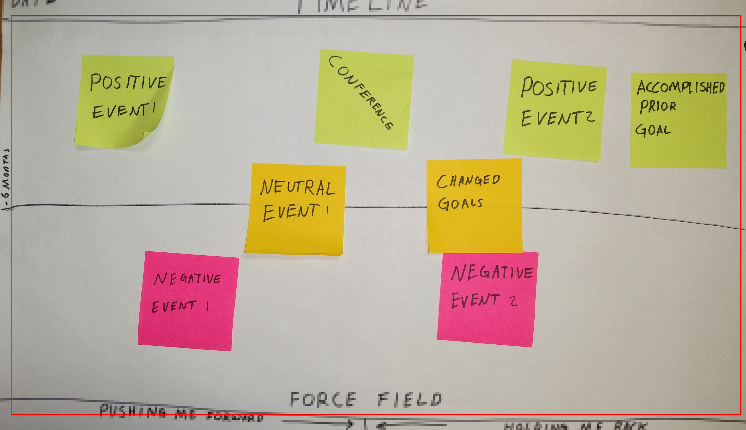
Time Line
@JasonKerney
Notes:
Comprehension listening

Slide 17
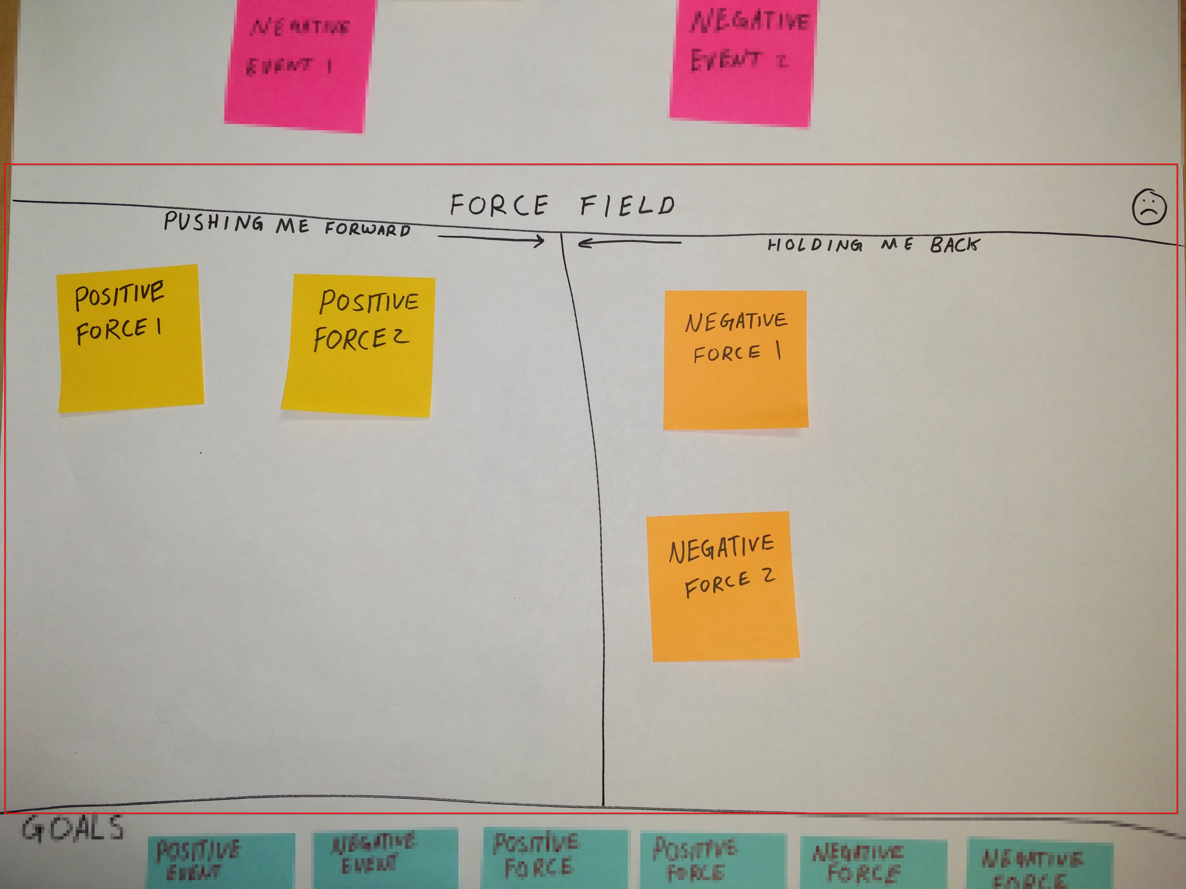
Force Field
@JasonKerney
Notes:
Comprehension listening

Slide 18

Goals
@JasonKerney

Slide 19
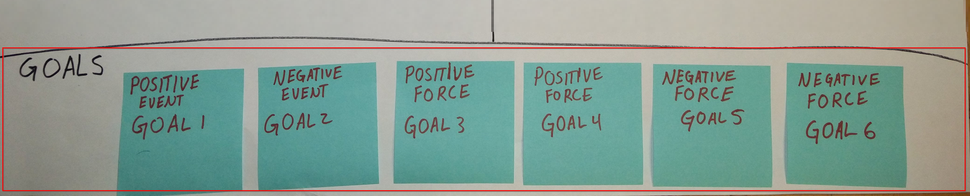
Goals
@JasonKerney

Slide 20

Closing the Retro
@JasonKerney

Slide 21

Adding to the Parking Lot
@JasonKerney

Slide 22
Adding To Parking Lot
@JasonKerney

Slide 23
Moving On
@JasonKerney

Slide 24

Talking to the Director
@JasonKerney
Notes:
Starts with anonymous survey
Discusses Goals
Ends with anonymous survey

Slide 25

Addressing Gamification
@JasonKerney
Notes:
Process is not tied to compensation
Completion or failure of goals is not the point. Discussion is.

Slide 26

Department Retro
@JasonKerney
Notes:
How can we make the process better?

Slide 27

Results (Stories)
@JasonKerney
Notes:
Other department started using it, despite very different context.
2 of their members said it generated some amazing insight.

Slide 28

Only Piece Of Advice
@JasonKerney
Notes:
Other department started using it, despite very different context.
2 of their members said it generated some amazing insight.

Slide 29
Revisit Parking Lot
@JasonKerney

Slide 30
Thank You!
@JasonKerney
jason.teamkerney.com
github.com/jason-kerney
spkr8.com/t/72511
www.functcon.com

